Slide 1
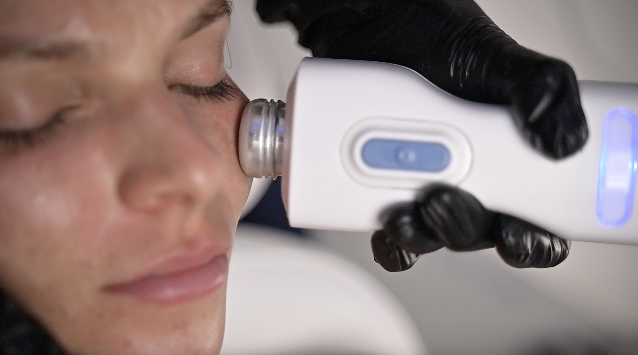
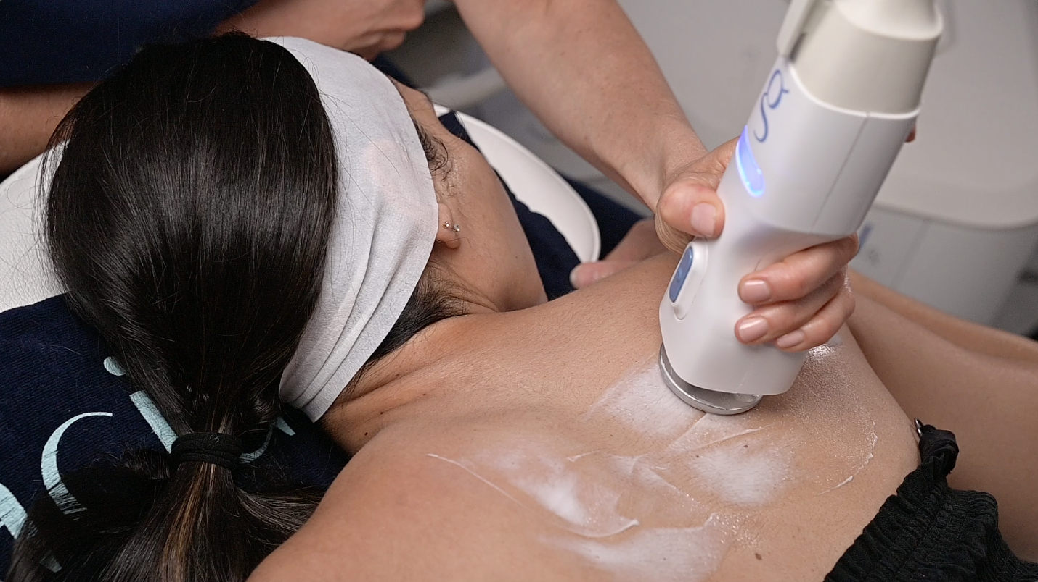
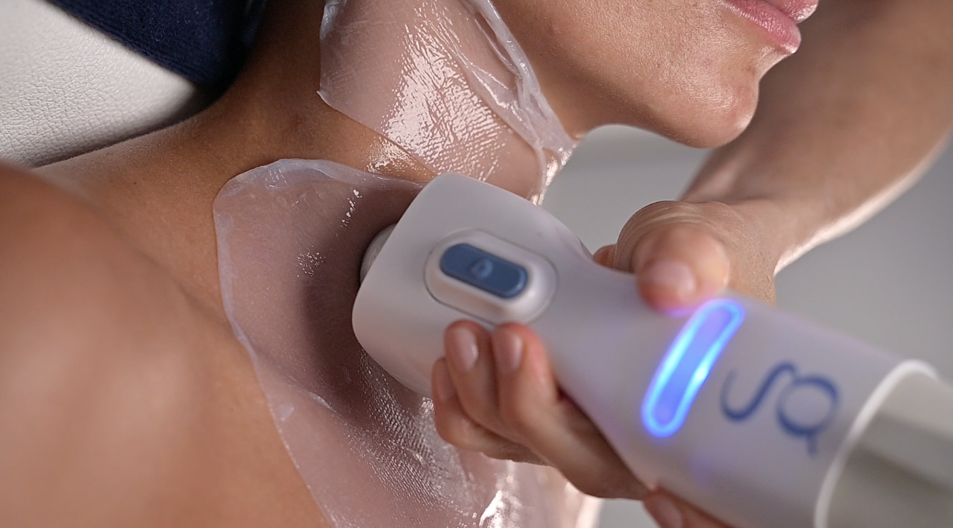

GLACIAL SKIN DIDACTIC TRAINING
®

Slide 2
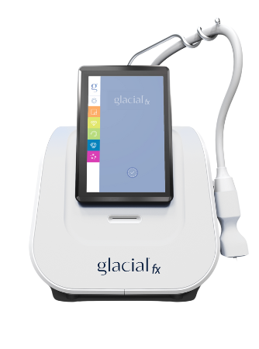
WELCOME TO #GLACIALNATION
REFRESH.
REBALANCE.
RESTORE.

Slide 3
WHAT TO EXPECT DURING TRAINING
MODULE 1: System Overview
MODULE 2: Skinflammation and the Science of Glacial® Skin
MODULE 3: Contraindications, Considerations and Patient Selection
MODULE 4: Glacial® Glide Protocol
MODULE 5: Glacial® Gloss Protocol

Slide 4
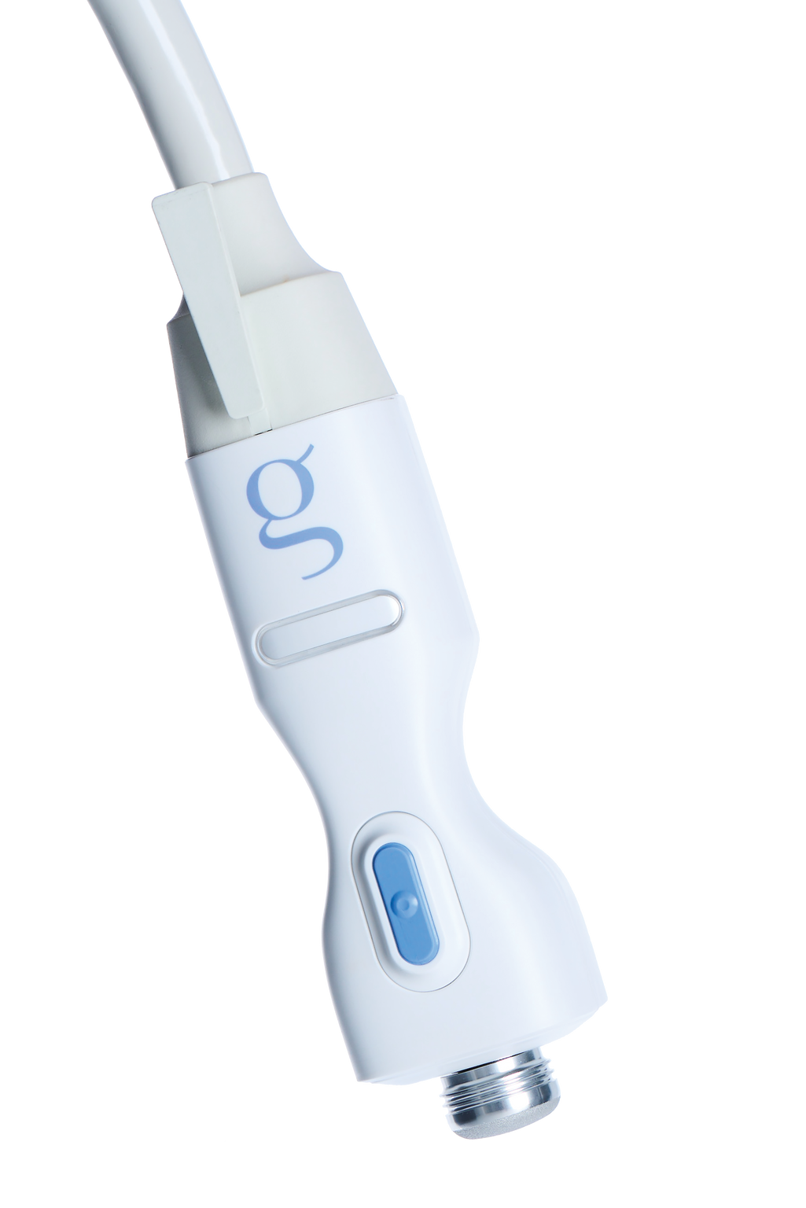
MODULE 1:
SYSTEM OVERVIEW

Slide 5
REFRESH • REBALANCE • RESTORE
Glacial® Skin is a controlled cooling device that fights premature aging caused by skin inflammation for healthier, younger-looking skin.

Slide 6


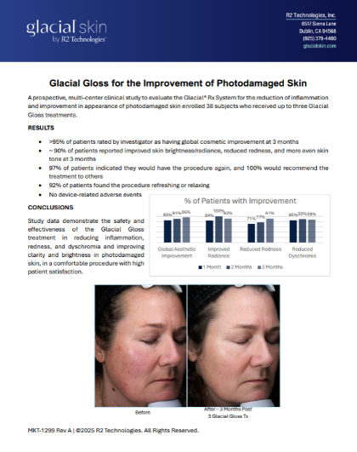
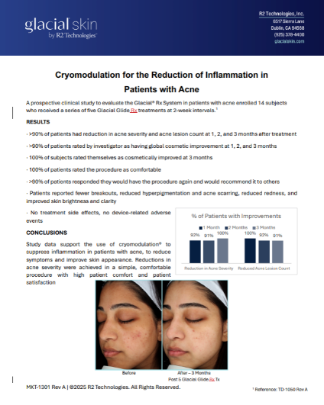

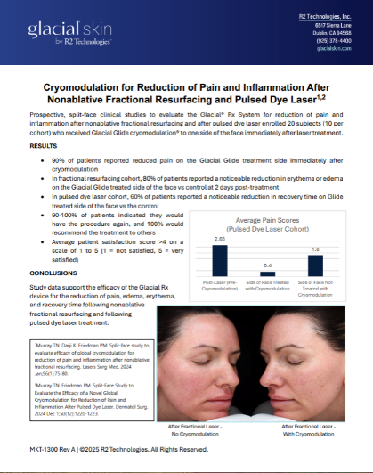
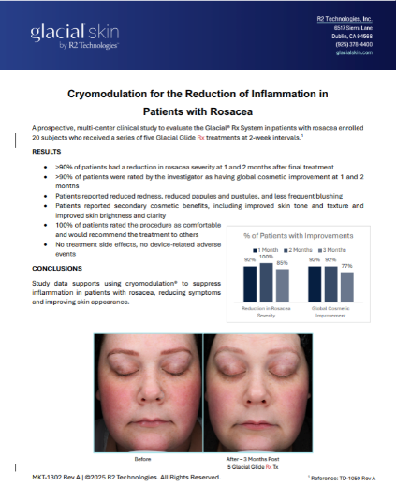
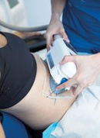
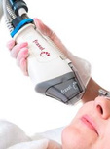
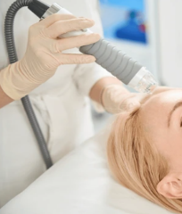
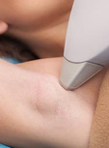
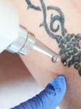
FOUNDED ON SCIENCE
and developed by world-renowned physicians
R. Rox Anderson,
MD
Dieter Manstein,
MD, PhD
Henry H.L. Chan,
MD, PhD
CREDITED INNOVATIONS
Cryolipolysis CoolSculpting
Fractional Resurfacing
Fraxel
Radio Frequency
Microneedling
Laser Hair Removal
Laser Tattoo Removal
> 100 ISSUED PATENTS

Slide 7

TWO TREATMENT OPTIONS
GLACIAL® GLOSS
Four-step treatment using a combination of controlled cooling and targeted topicals to fight premature aging caused by inflammation
30-Minute Treatment
GLACIAL® GLIDE
A 10-minute extended cooling treatment that will have you feeling relaxed, calmed, and refreshed. Great as an add-on to other treatments to calm the skin.
10-Minute Treatment

Slide 8

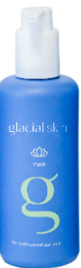


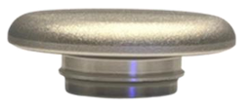

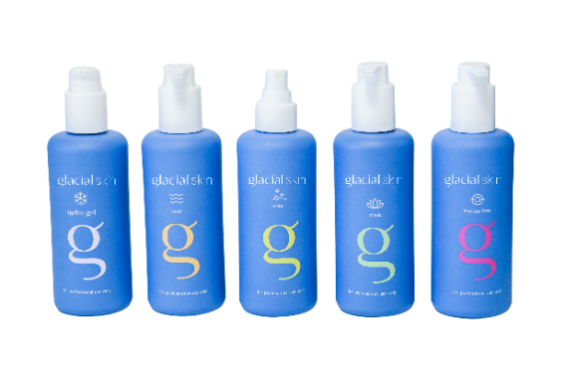


TREATMENT EXPERIENCE
MODE TREATMENT CONSUMABLES
1-step
10 min
GLACIAL®
GLIDE
GLACIAL® SKIN MASK
Average price
$149
SMOOTH TIP
BODY TIP
40x TREATMENT CARD
4-steps
30 min
GLACIAL®
GLOSS
SMOOTH TIP
TEXTURED TIP
GLACIAL® SKIN HYDRO GEL, PEEL, MIST, MASK & MOISTURIZER
Average price
$300-500
BODY TIP
40x TREATMENT CARD

Slide 9

JUST LIKE HEAT MODALITIES,
NOT ALL COLD TREATMENTS ARE EQUAL
What makes the difference?
    HEAT EXTRACTION
    IS THE MOST IMPORTANT
    TEMPERATURE
    CONTROL
    TIME
    ACCURACY

Slide 10
GLACIAL SKIN TECHNOLOGY:
ACTIVE COOLING
THERMOELECTRIC COOLER (TEC)
CONTACT COOLING
LIQUID CIRCULATION
Higher thermal conductivity
Greater removal of excess heat
Localized cooling
Enhances heat removal
Keeps the skin at a controlled temperature
Feedback controlled temperature algorithms

Slide 11
MODULE 2:
THE SCIENCE OF GLACIAL® SKIN

Slide 12
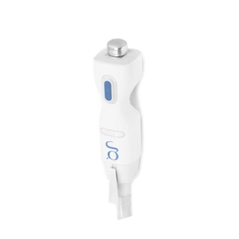

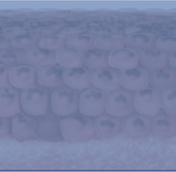
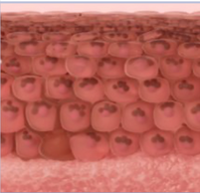
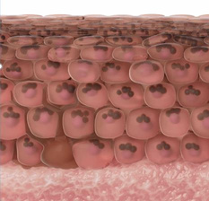
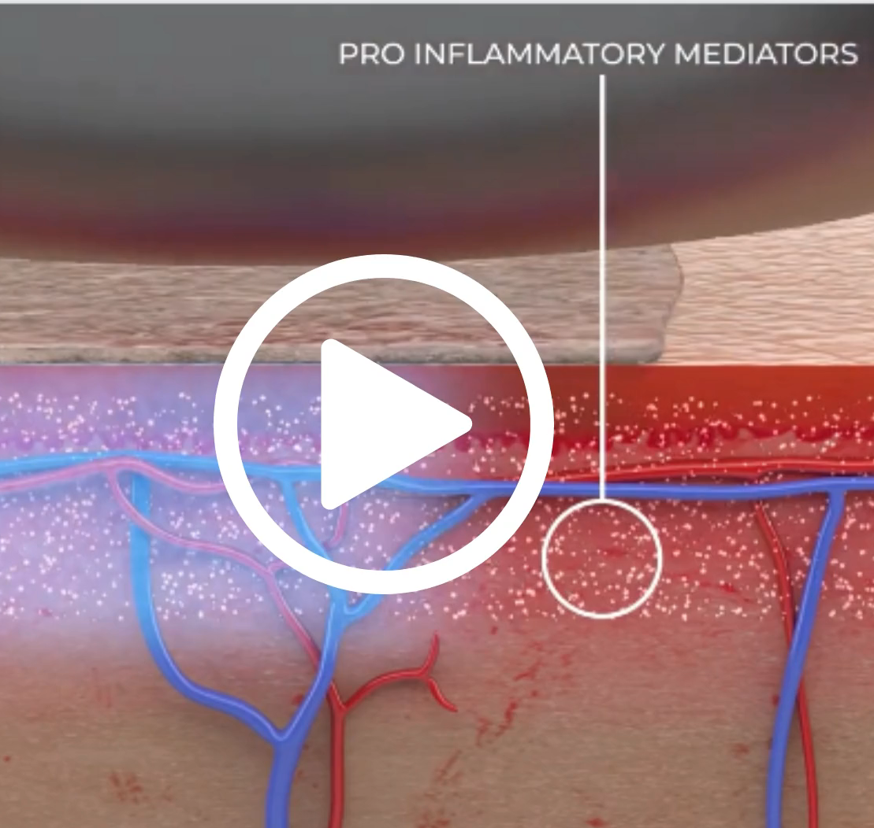

GLACIAL® GLIDE & GLACIAL® GLOSS
How do we treat signs of skin aging caused by inflammation?
Controlled cooling is uniformly applied to the skin.
Cooling calms the skin and reduces redness and puffiness.
Skin appears brighter, healthier, and more youthful.

Slide 13
MODULE 3:
CONTRINDICATIONS, CONSIDERATIONS,
AND PATIENT SELECTION

Slide 14







GLACIAL® SKIN FOR EVERYONE
Suitable for any patient, at any time, on any part of the body.
SAFE & ENJOYABLE
NO DOWNTIME
REAL RESULTS
ALL AGES
ALL GENDERS
ALL SKIN TYPES

Slide 15
PATIENT SELECTION
Contraindications and Considerations
CONSIDERATIONS:
  An underlying cold-sensitive condition that could be exacerbated by topical cooling (e.g., cold urticaria, Raynaud’s disease, cryoglobulinemia)
  Compromised circulation to the extremities
  An open wound or any active infection in the treatment area
CONTRAINDICATION:
  A suspicious lesion that has yet to be diagnosed
  Confirmed diagnosis of skin cancer in the treatment area**
ALSO CONSIDER :
  Known history of skin allergies or sensitivities to any skincare products or specific ingredients in skincare products (e.g., compounds such as fruit extracts, enzymes, or chemical peel agents *​
  Recent dermabrasion, laser, or skin resurfacing treatment requiring prolonged healing​
  Recent use of topical exfoliants (e.g., retinoid, retinol, glycolic acid, salicylic acid, etc.)​
  Acne and/or history of acne scarring or recent use of Accutane ​
*When utilizing commercially available topicals during administration
**Patient selection is ultimately at the discretion of the treating provider. Areas considered for treatment should be properly diagnosed.

Slide 16
MODULE 4:
GLACIAL® GLOSS PROTOCOL

Slide 17
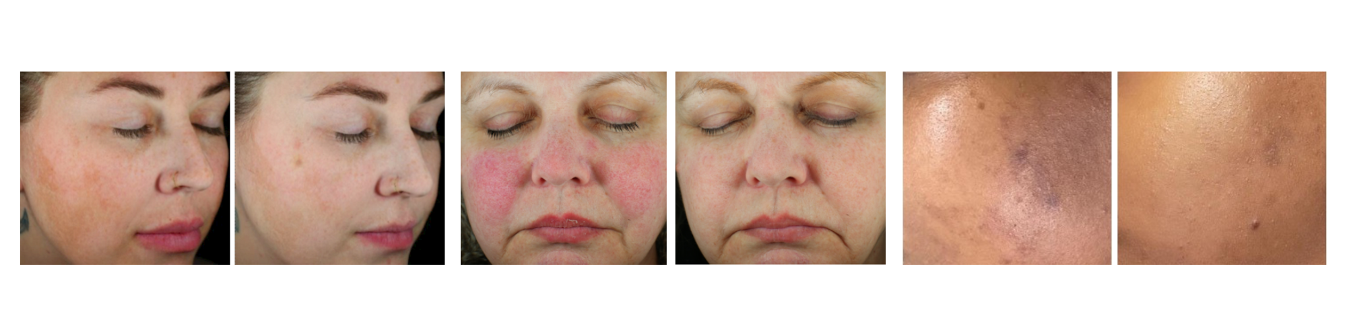
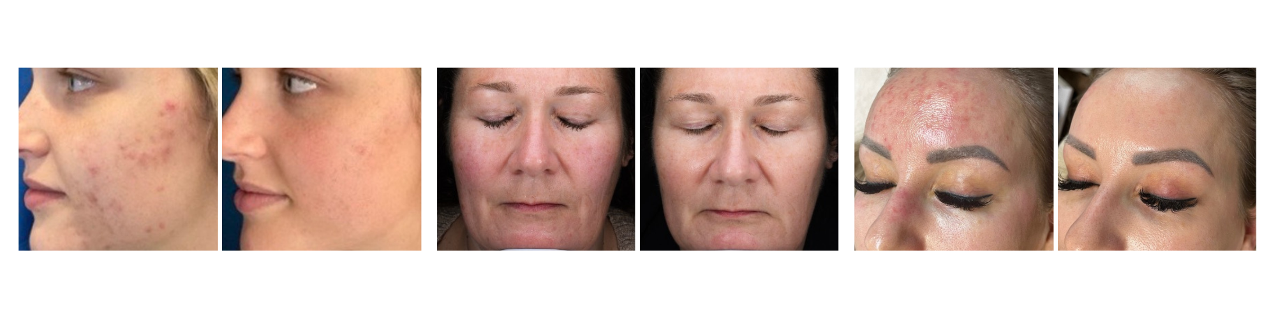
TREATMENT OPTIONS |
GLACIAL® GLOSS
Uneven Skin Tone
Visible Redness
Skin Discoloration
Can be Used in Clients with Acne
Dullness and Uneven Texture
Skin Irritation

Slide 18
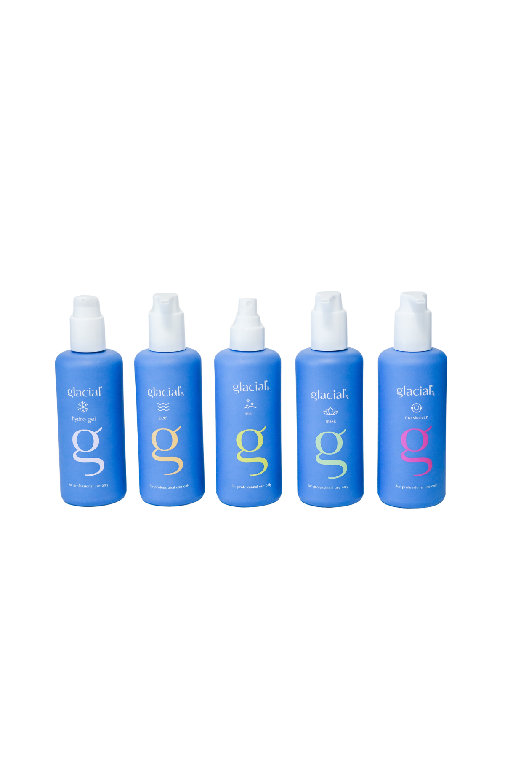




GLACIAL® SKIN TOPICALS GUIDE
GLACIAL® SKIN PEEL
Chemical exfoliator for increased skin radiance and luminosity
Key ingredients: 8.13% Glycolic + Lactic + Salicylic Acid, Licorice Root Extract and Pomegranate Enzymes.
GLACIAL® SKIN MASK
Instantly replenishes moisture, soothes, and boosts essential microbiome.
Key ingredients: Aloe Vera, Hyaluronic Acid, Royal Honey and Beta Glucan.
GLACIAL® SKIN MIST
An alcohol-free mist that hydrates and refines the appearance of pores.
Key ingredients: Lactobacillus, Vitamin C and Palmitoyl Peptides.
GLACIAL® SKIN MOISTURIZER
Protects skin against pollution, damage, and inflammation, while firming and restoring a healthy barrier.
Key ingredients: Niacinamide, Palmitoyl Peptides, Ceramide, Vitamin C, and Moringa Seed Extract.

Slide 19






GLACIAL® GLOSS STEP BY STEP
CLINICAL PEARLS:
Apply products with an application tool i.e., mask brush, or silicone spatula.
When using the smooth tip, treat with constant, continuous, slow, gliding motions. Deliver equal time to treatment areas.
When using a textured tip on the face, start on the cheeks first, treat the forehead last; and assess skin response after each pass.
*Alternatively, Glacial® Mist can be applied with a fan brush directly to the treatment area.
**Adjust the desired exfoliation by reducing hand pressure or adding additional mist.
Apply 3 pumps of Glacial® Skin Peel to cleansed treatment area.​
​
Push the button on the handpiece to start cycle.* ​
​
After cycle, leave Peel on the skin for 5-minutes. Refer to timer.​
​
Remove Peel with water-saturated sponge/non-woven gauze. ​
​
Wipe smooth tip, remove and set aside.
Apply Glacial® Skin Hydro Gel to the textured tip and attach. Direct client to hold their breath and close their eyes as you spray* Glacial® Skin Mist directly on the treatment area. ​
​
Push the button on the handpiece to start cycle.​
​
Perform only two passes over each area. Assess skin response after each pass.**​
​
Apply additional Mist as needed (up to 14 sprays total per treatment.) Wipe the skin with a sponge/non-woven gauze. ​
​
Remove and discard the textured tip.
Add Glacial® Skin Hydro Gel inside the smooth tip and attach the tip to the handpiece.​
​
Apply 3 pumps of
Glacial® Skin Mask to the treatment area.​
​
Push the button on the handpiece to start cycle.* ​
​
After cycle leave Mask on the skin for 5 minutes. Refer to timer. ​
​
Remove Mask with water-saturated sponge/non-woven gauze. ​
​
Wipe smooth tip.​
Add Glacial® Skin Hydro
Gel inside the smooth tip and attach the tip to the handpiece.​
​
Apply 3 pumps of
Glacial® Skin Moisturizer
to the treatment area.​
​
Push the button on the handpiece to start cycle.* ​
​
After cycle leave the Moisturizer on the skin for 5-minutes. Refer to timer. ​
​
Remove Moisturizer with water-saturated sponge/non-woven gauze. ​
​
Discard smooth tip.​
Insert the​
Glacial® Gloss fx treatment card and touch the check icon.​
​
Apply Glacial® Hydro Gel inside the well of the smooth tip and attach the tip to handpiece.

Slide 20
POTENTIAL SIDE-EFFECTS
  Glacial® Gloss and Glacial® Glide Cooling Treatments
Potential Side-Effects of Cooling Treatment | Average Duration (results will vary; may take longer for some patients)
Transient Redness and Sensitivity | 1 – 3 days
Mild Skin Irritation | 1 – 3 days
R2-16-001 Interim Report: Evaluation of a New Dermal Cryotherapy System for the Treatment of Benign Pigmented Lesions

Slide 21
POTENTIAL SIDE-EFFECTS
  Glacial® Gloss Treatment with Topicals
Potential Side-Effects of Glacial® Gloss fx with Topicals | Average Duration (results will vary; may take longer for some patients)
Transient Redness and Sensitivity | 1 – 3 days
Skin Sensitivity to Sun Exposure | 1 to 10 days
Mild Skin Irritation | 1 – 7 days
Temporary Skin Dryness | 1 – 7 days
Temporary Skin Purging/Acne Breakout | 1 – 14 days
R2-16-001 Interim Report: Evaluation of a New Dermal Cryotherapy System for the Treatment of Benign Pigmented Lesions

Slide 22
MODULE 5:
GLACIAL® GLIDE PROTOCOL

Slide 23
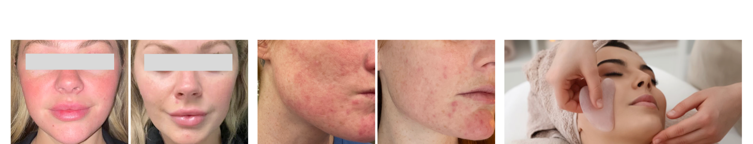
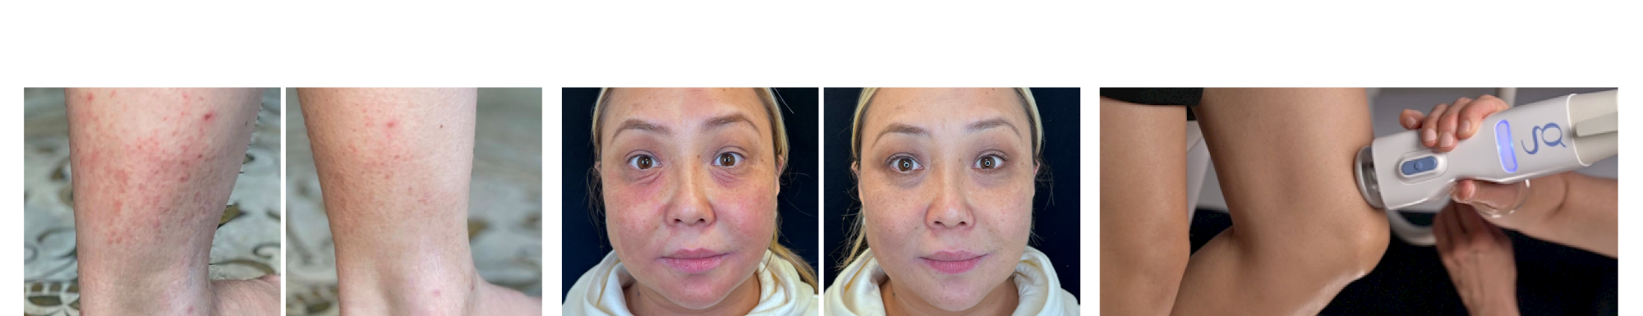
TREATMENT OPTIONS |
GLACIAL® GLIDE
Can be Used in Clients with Rosacea
Clearer Skin
Lymphatic Drainage
Body
Can be Used in Clients with Eczema
Soothes Aches and Soreness

Slide 24

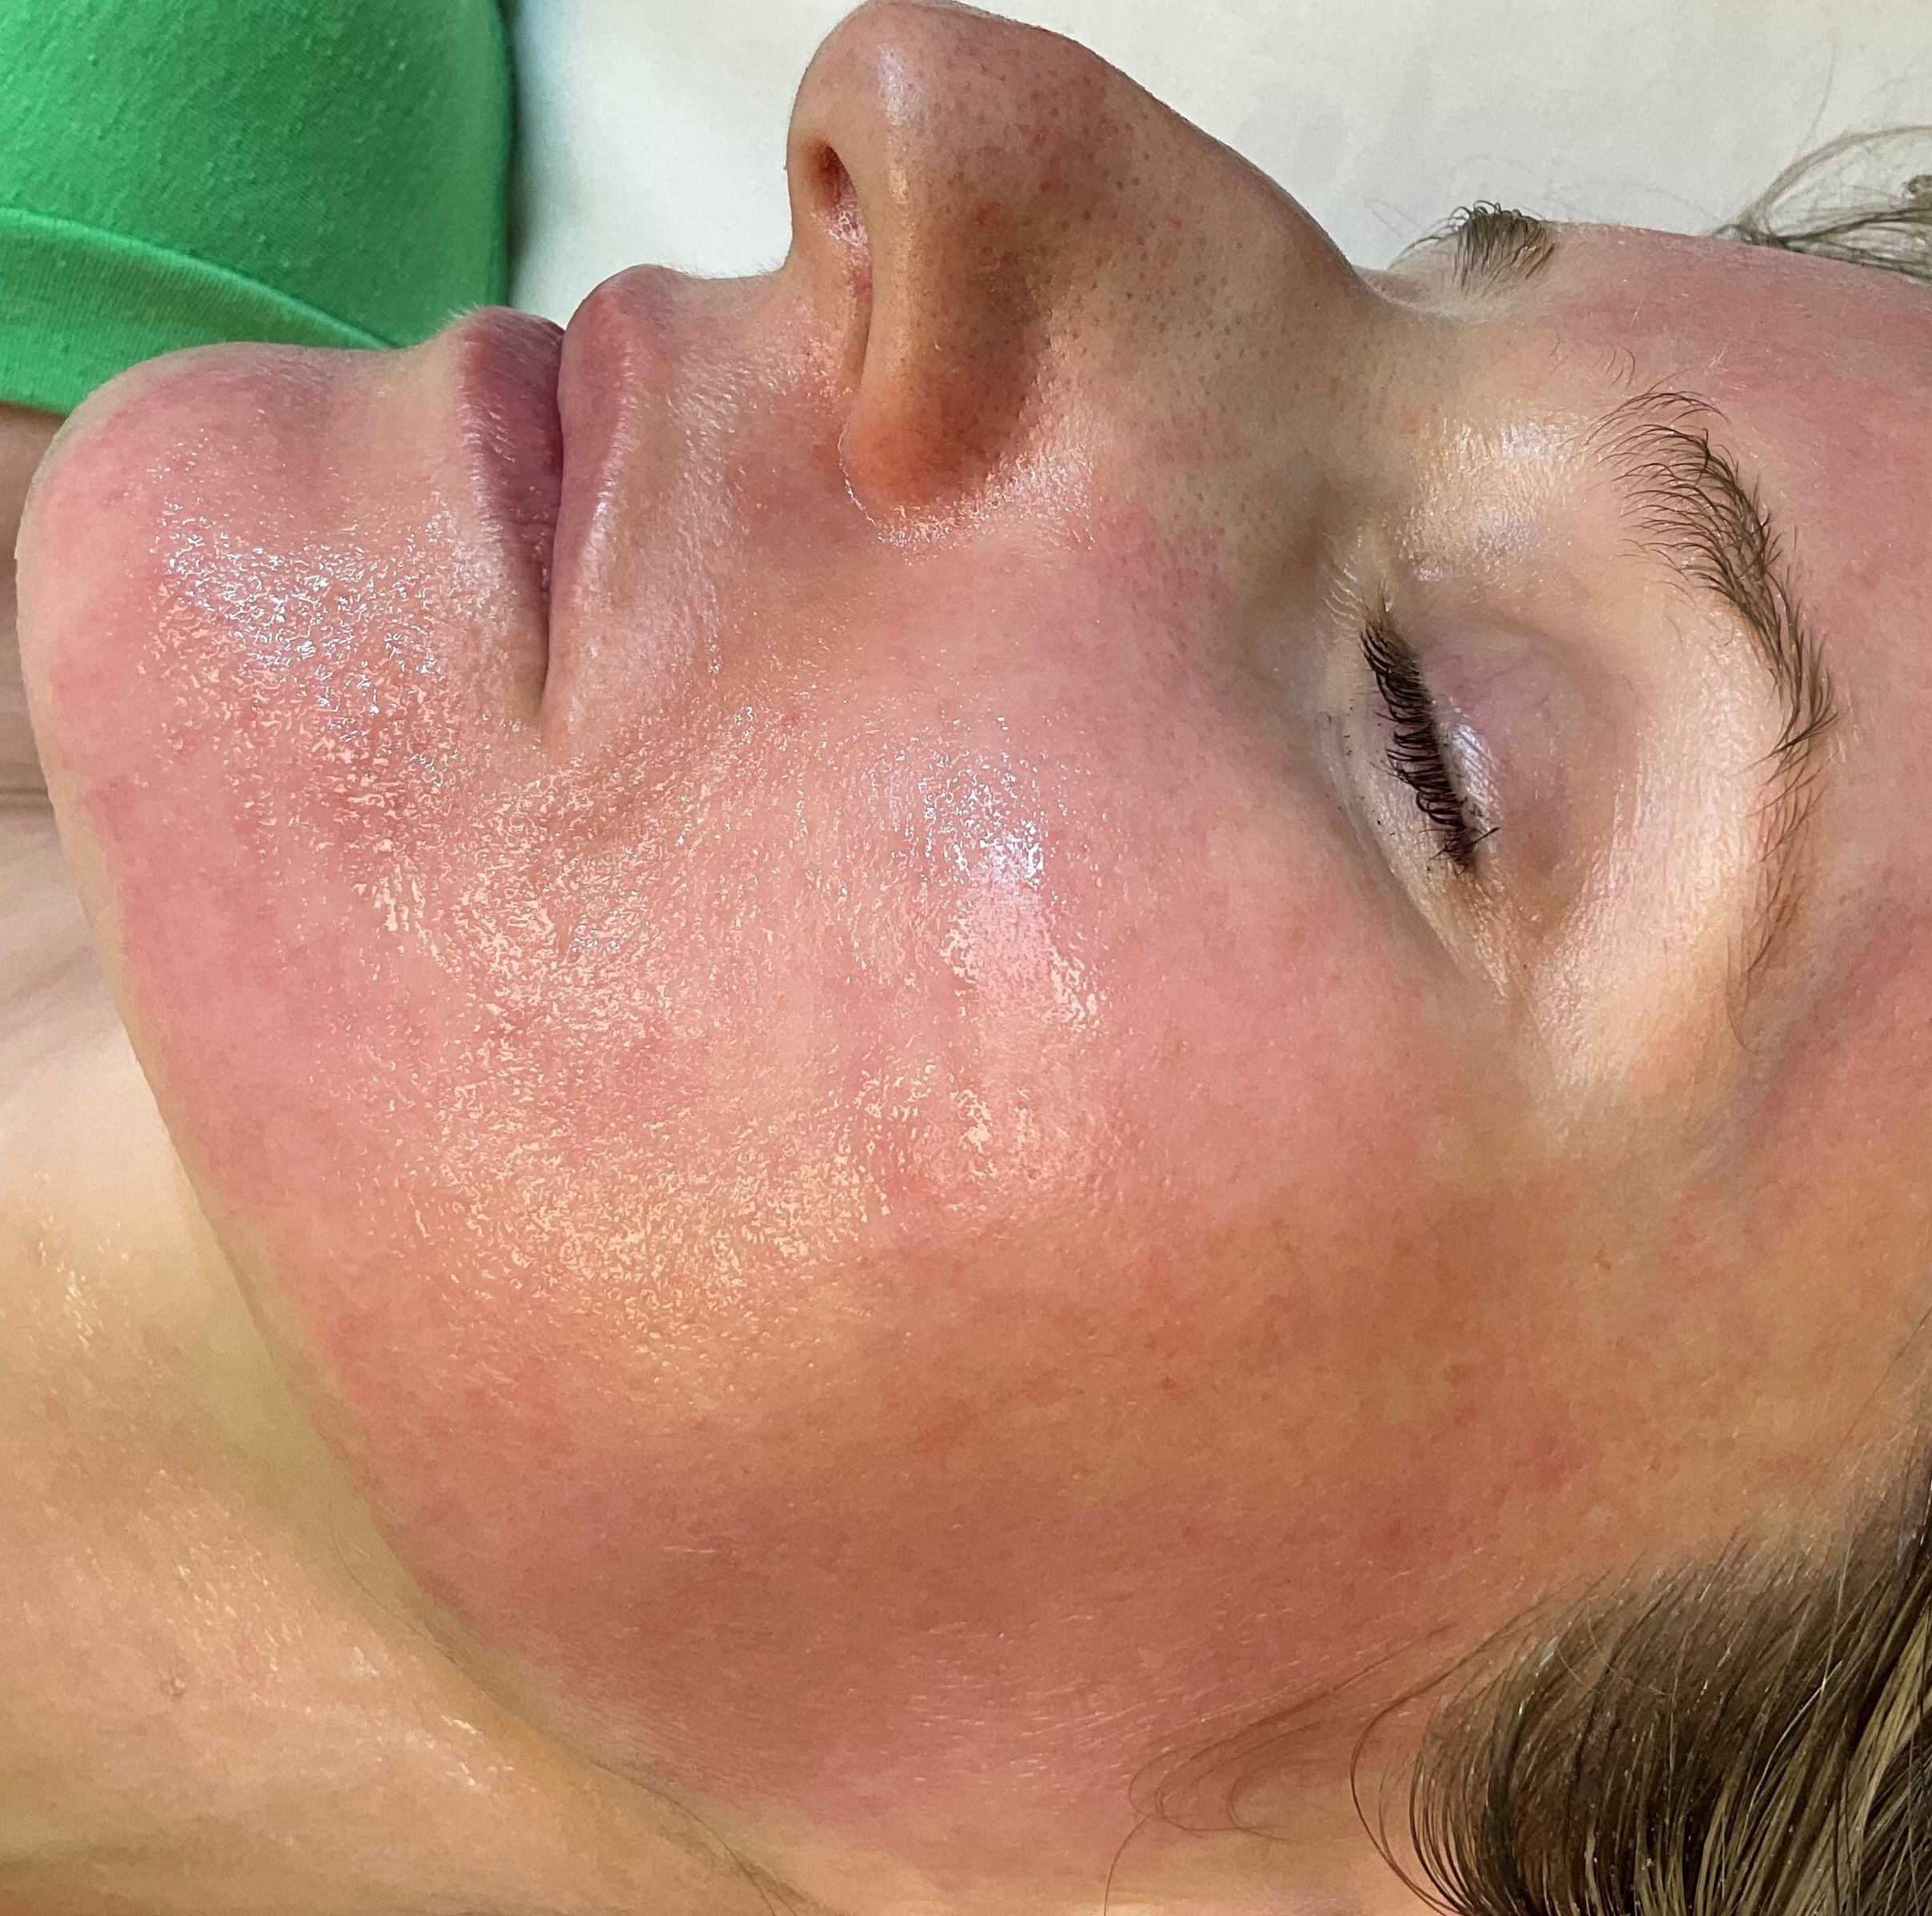
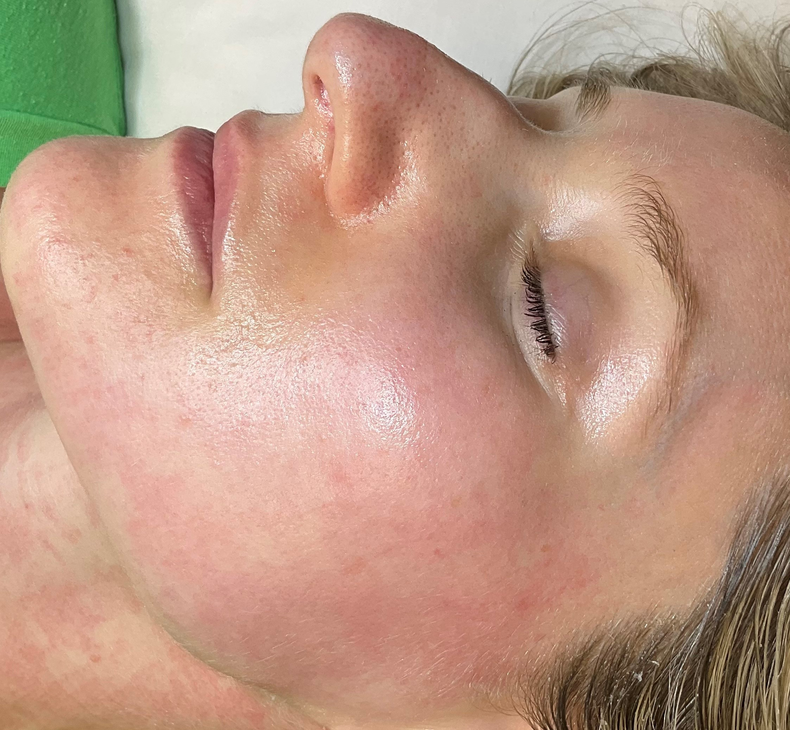
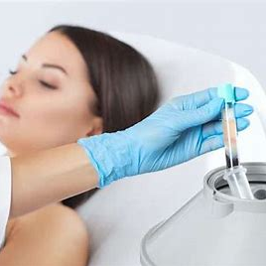
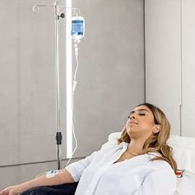
TREATMENT OPTIONS |
GLACIAL® GLIDE
PRE, POST & COMBINATION TREATMENTS
Post Powered Facials
Pre Injectables
Post Dermaplaning
Post Heat Modalities & Microneedling
Post Massage
PRP Combo
IV Drip Combo
Post Workout
Red Light Combo

Slide 25
GLACIAL® GLIDE STEP BY STEP
1
2
3
GLACIAL® GLIDE CONSUMABLES:
Complete boot up before inserting card or attaching tip, holster handpiece untouched to prevent errors.
Insert Glacial® Glide treatment card and touch check icon
Apply Glacial® Hydro Gel inside tip and attach tip to handpiece
MASK
SMOOTH TIP
TREATMENT CARD
**Purpose of Mask: To facilitate the gliding motion of the handpiece tip on the skin; other products may be substituted.
Additional Notes:
Patient contact must occur within 15 seconds of starting a Glacial® Glide treatment to avoid error
Verify start of treatment by timer count down
Once treatment is activated, apply light pressure, constant motion, slow to moderate speed; do not lift tip off tissue
Treatment may be permanently canceled by pressing the (‘X’) on the display screen
When the treatment is complete, the handpiece beeps and the treatment status indicator blinks yellow
4
5
6
7
Press banner on the home screen to advance to treat screen
Apply 3 pumps
of Glacial® Mask**
to the treatment area
Press the blue button
on the handpiece when ready, begin treating by placing the handpiece on the treatment area
Treat with constant,
slow, gliding motion,
concentrating time
equally across
treatment area

Slide 26
GLACIAL® GLIDE TREATMENT
SINGLE VS. SERIES
A SERIES OF TREATMENTS OR ONGOING MAINTENANCE PLAN
SINGLE TREATMENT OR ADD-ON
ACUTE:
Treatment following specific event or occurrence.
CHRONIC:
For clients experiencing lifestyle-related or chronic conditions:
Post Laser/Heat Based Modalities
Post Microneedling
Post Injection
Post Minor Surgical Procedure
Post Waxing
Post Extractions
Post Injury
Delivered immediately post-treatment
Redness
Puffiness
Dullness
Uneven Tone
Sensitivity
Aggressive skincare Acclimation
3 or more treatments; depending on:
      baseline condition
      patient expectations
Mild every 4 weeks
Moderate-severe every 1-2 weeks

Slide 27
BENEFITS OF COLD POST-TREATMENTS
TREATMENT | Post-Laser (controlled damage to stimulate skin regeneration) | Post-Microneedling (creates tiny controlled injuries to stimulate collagen) | Post-Radiofrequency (heats the skin to stimulate collagen production)
CALMS THE SKIN | Cold therapy removes excess heat, reducing prolonged redness and swelling early, ensuring it doesn’t persist and affect results. | Promotes faster recovery, keeping the healing process on track. | Cold therapy reduces skin irritation, accelerating skin recovery
PROVIDES IMMEDIATE RELIEF | Cold therapy slows nerve signal transmission, offering instant relief from burning and stinging sensations. | Soothes irritation, reducing discomfort from microneedling punctures. Minimizes redness right after treatment. | Cold reduces the heat-induced discomfort, making recovery more comfortable.
PROTECTS SKIN & ACCELERATES HEALING | Cold therapy constricts blood vessels, reducing damage from inflammation and speeding up skin recovery. | Cold therapy prevents an exaggerated immune response and promotes efficient healing. | Cold reduces heat-related damage, reduces swelling and downtime, and promotes faster healing.
ENHANCES RESULTS | Optimizes results by reducing downtime and supporting a more even skin tone and texture. | Minimizes post-treatment swelling and irritation leading to more radiant, healthy skin and better overall outcomes. | Promotes optimal healing for more noticeable, long-lasting results.

Slide 28
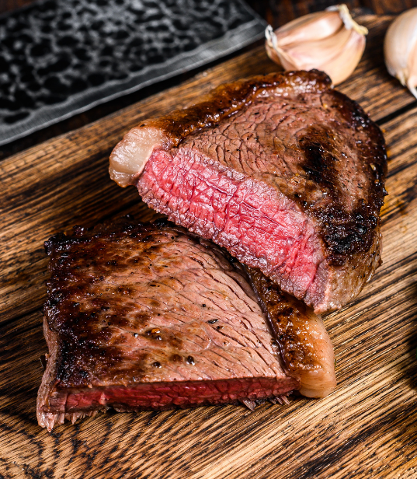
COMBINATION TREATMENT MYTH-BUSTING
Will cold suppress results?
There is no evidence that supports a reduction in the healing response or clinical results due to application of cold.
The controlled injury (desired effect) occurs at the time of energy delivery
Excess heat trapped in the skin creates unnecessary discomfort and elongates the social downtime and recovery

